Slide 1
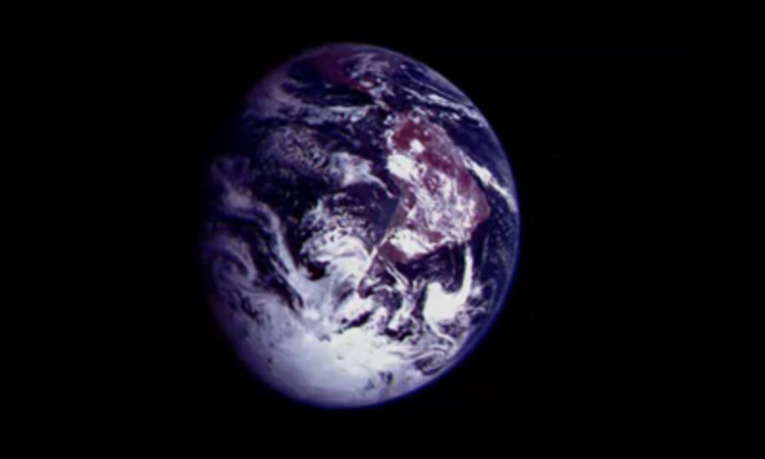
Our Earth

Slide 2
Pollution
Pollution can take many forms. The air we breathe, the water we drink, the ground where we grow our food.

Slide 3
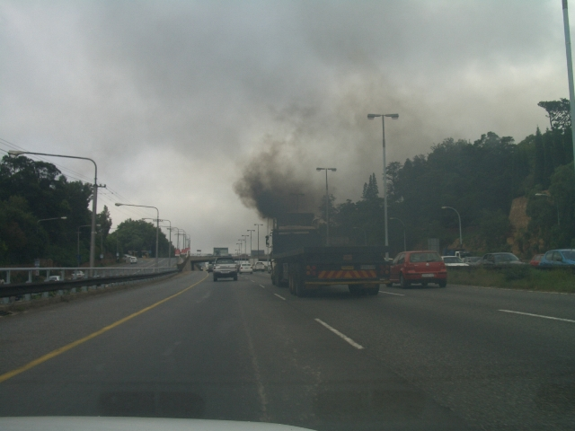
Air Pollution
The exhaust gases of nitrogen dioxide in the air above the content of 0.000002%.

Slide 4
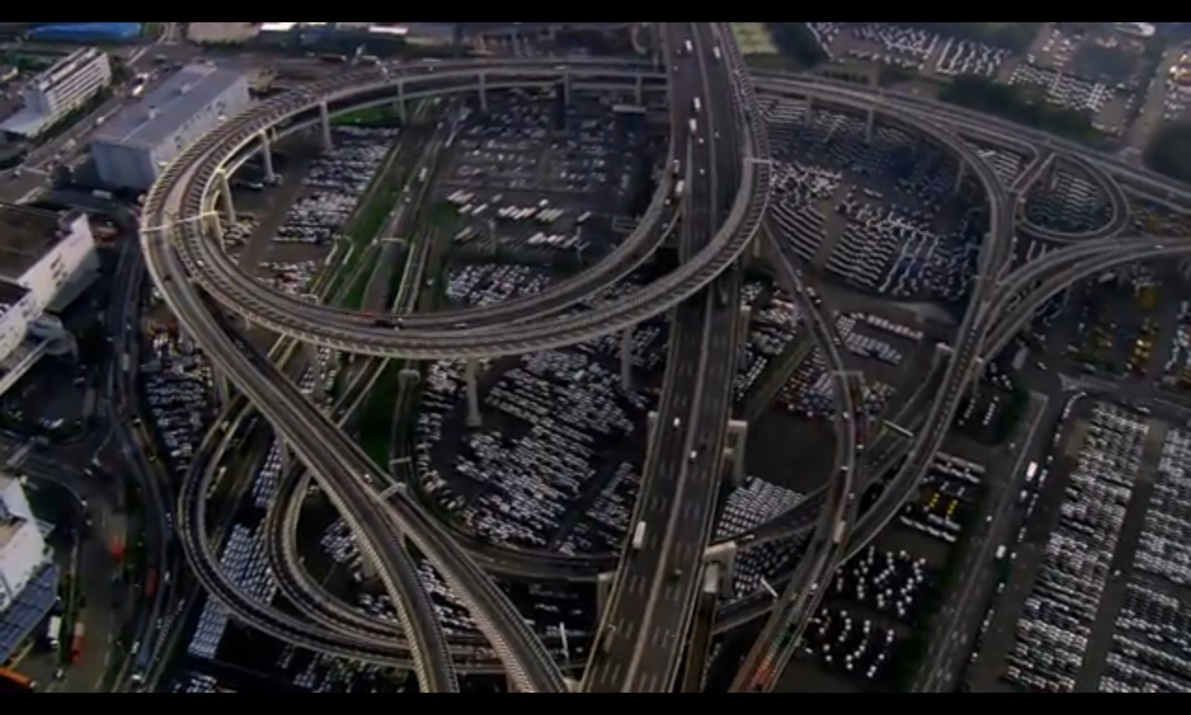
The cars of lead and carbon monoxide issue. Smog and ozone in the air may cause asthma.

Slide 5
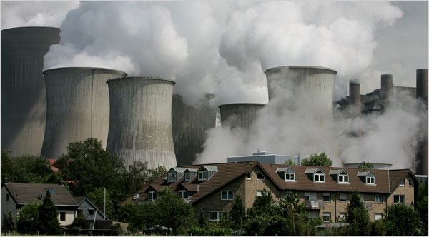
Every year 700,000 people die from above is less when these air pollutants withdrawn.

Slide 6
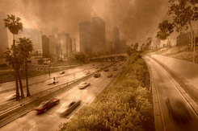
2010, estimates the number of motor vehicles, compared with 1990 and 580 million data.

Slide 7
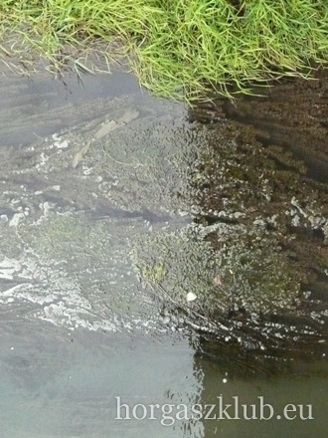
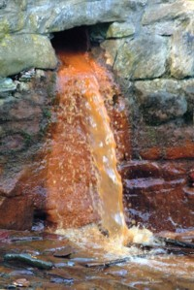
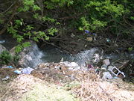
Water Pollution
The antecedent of the algae to the sea of fertilizer, and cleaned with high nitrate and phosphate is water.

Slide 8
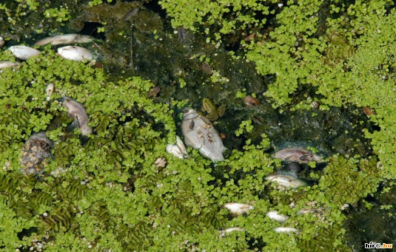
The fish and other aquatic organisms can not get enough sunlight.

Slide 9
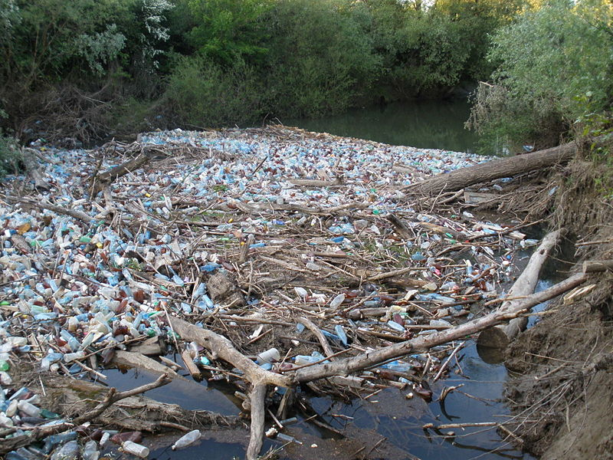
A city with one million population per year 500 000 tonnes of waste water is produced.

Slide 10
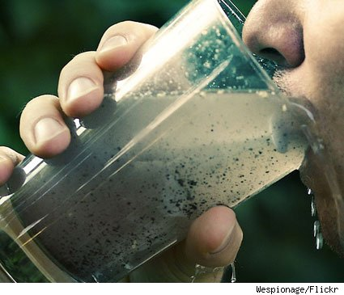
5000 people a day die because of dirty drinking water. 1 billion people have no acress to safe drinking water.

Slide 11
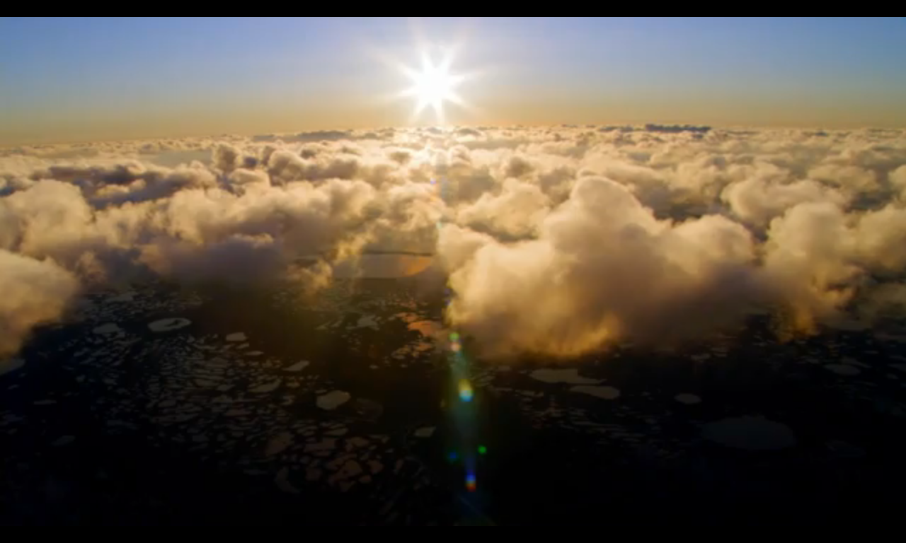
20 % of the world’s population consumes 80 % of its resources.
20 % of the world’s population consumes 80 % of its resources.

Slide 12
The oceans each year: - 2.6 million tons of nitrate - 2.5 million tonnes of zinc, - 370 thousand tons of lead is.

Slide 13
The average temperature of the last 15 years have been the highest ever recorder.

Slide 14
The rivers and lakes is 300 billion liters of water.

Slide 15
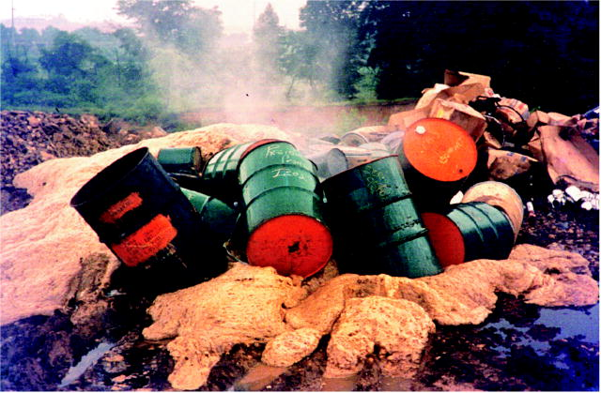
About 400 million tons of hazardous wastes are generated each year.

Slide 16
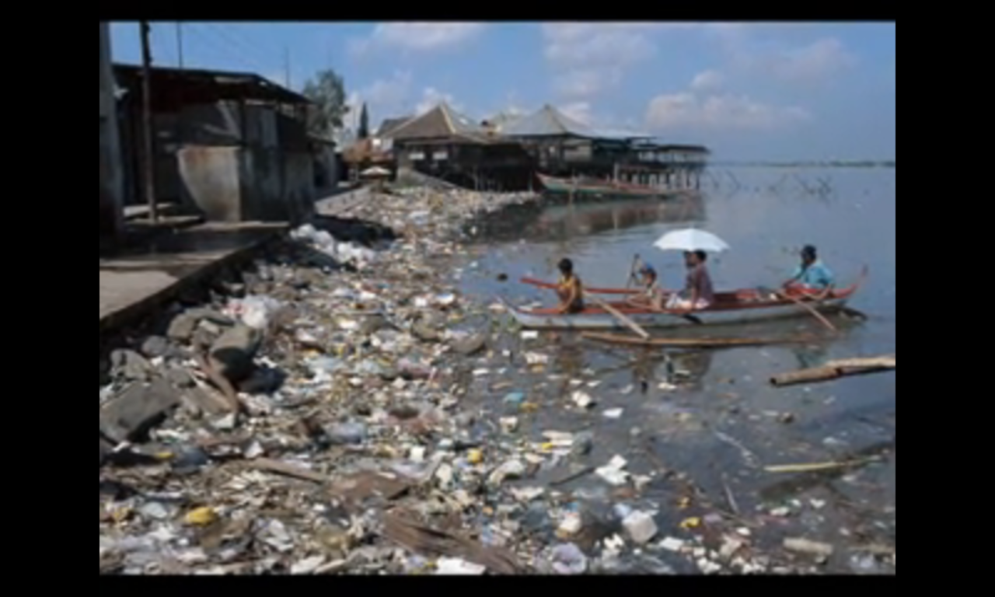
The USA alone produces about 250 million tons.

Slide 17
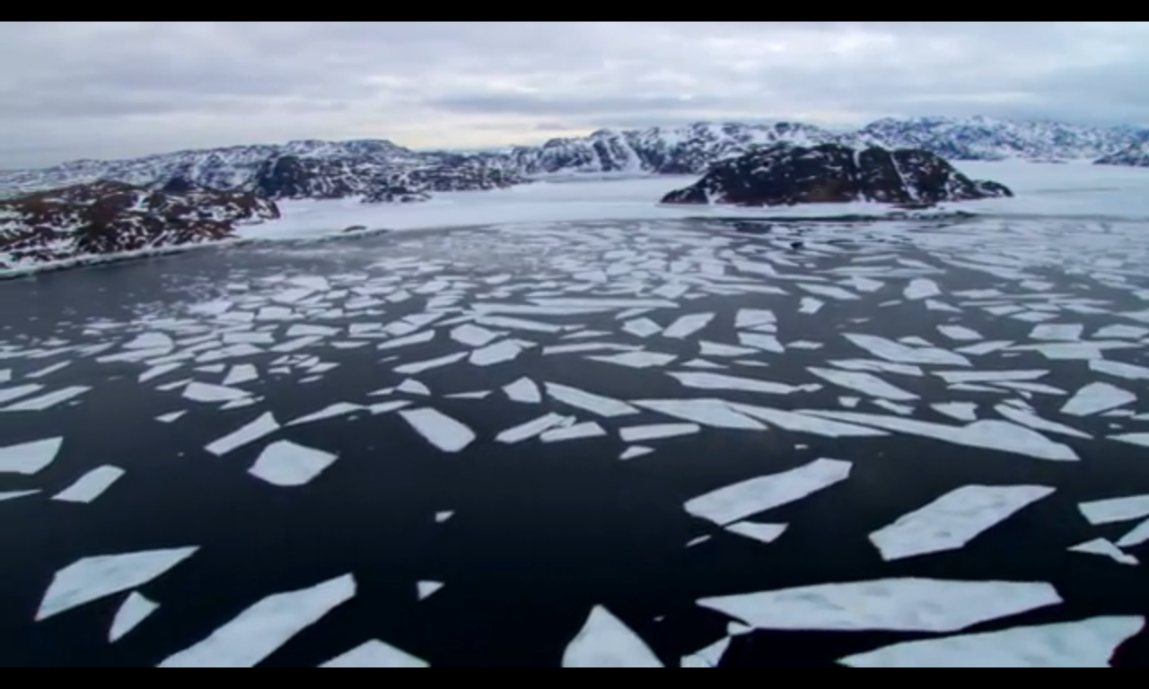

Slide 18
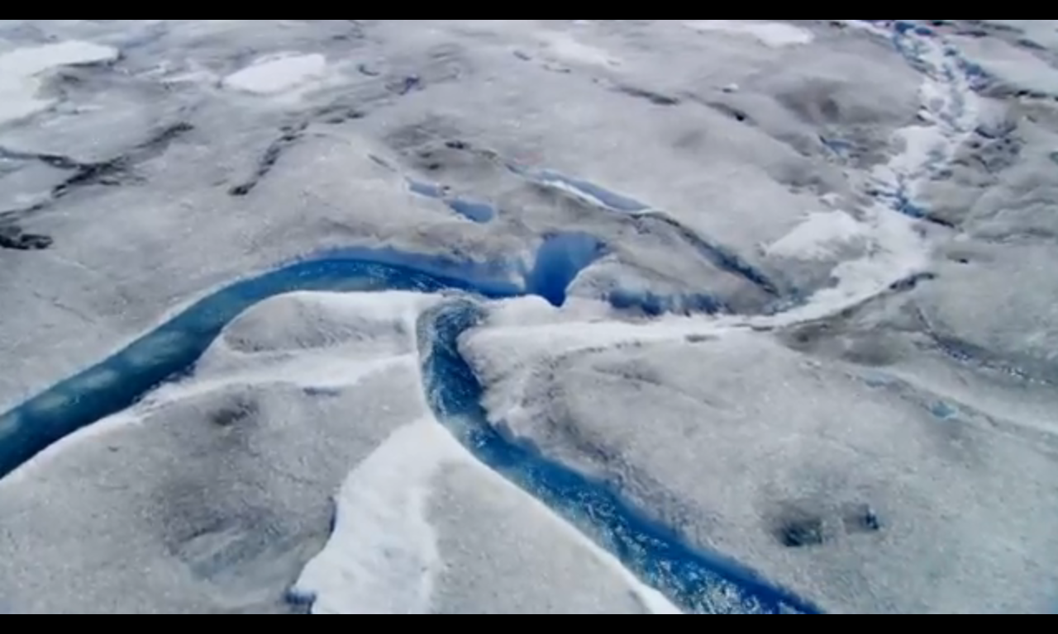

Slide 20
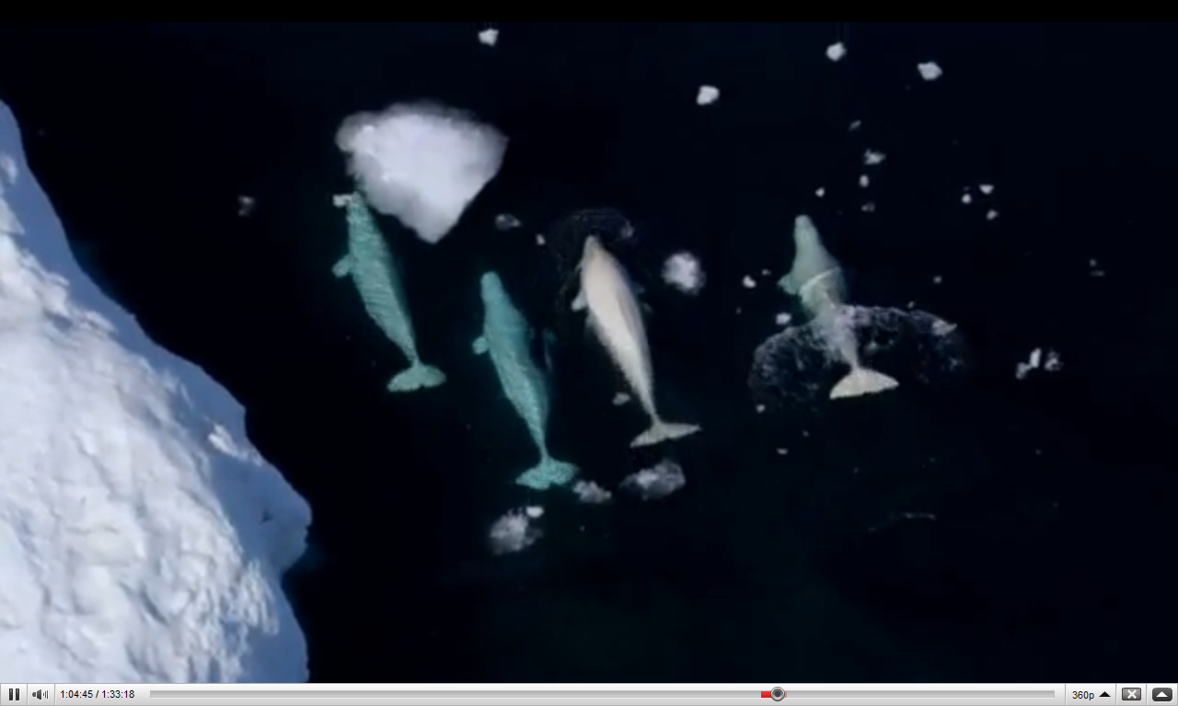

Slide 21
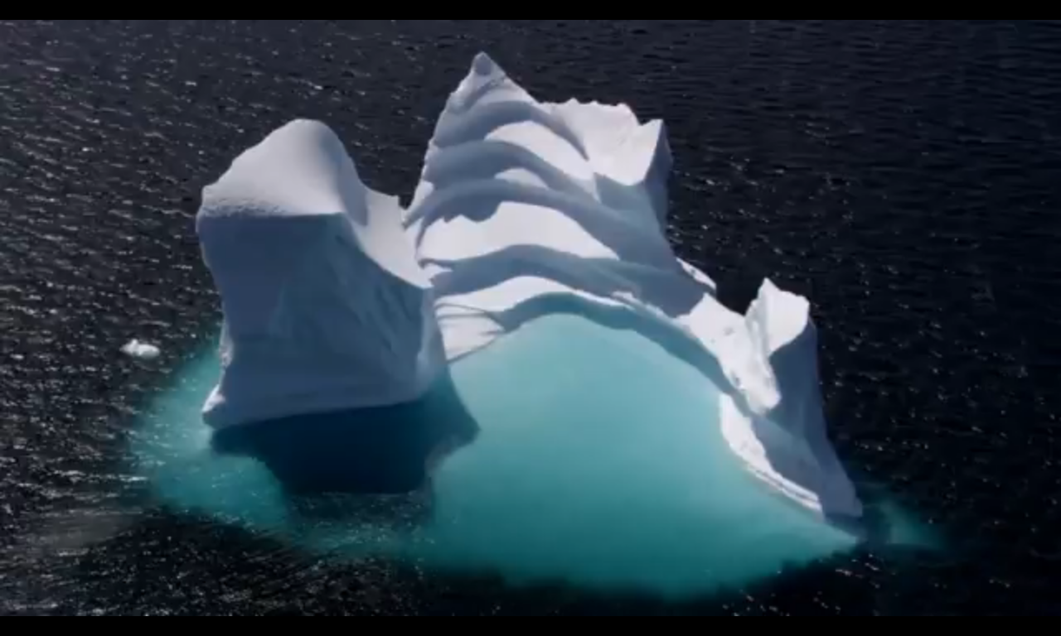
There may be at least 200 million climate refugees by 2050.

Slide 22
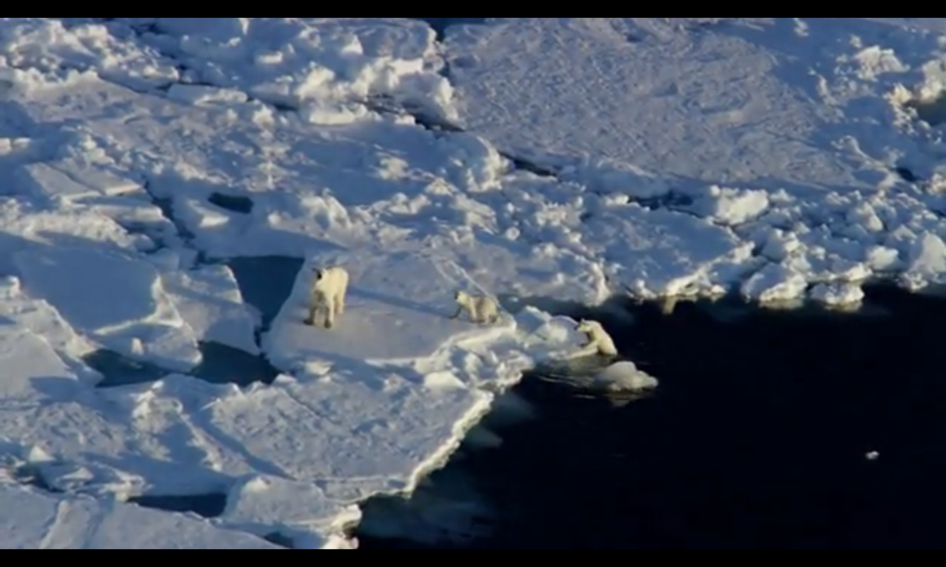

Slide 23
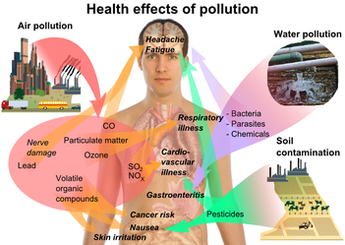

Slide 24
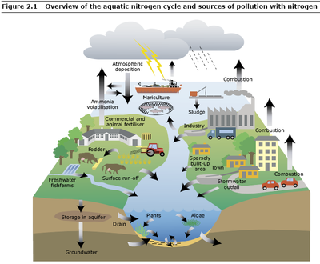

Slide 25
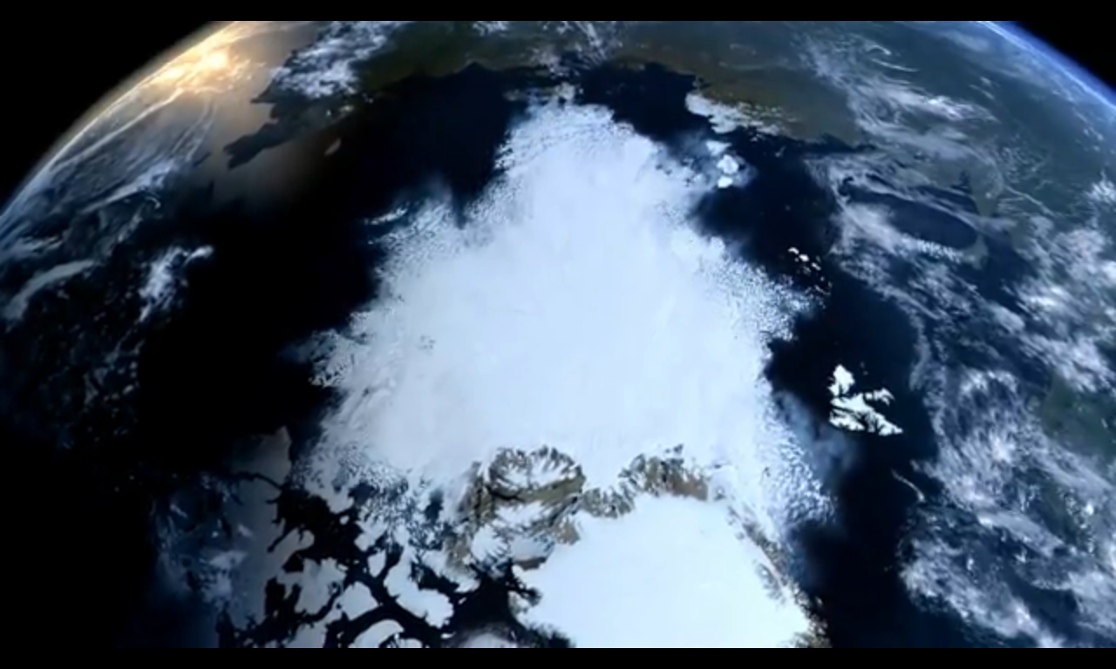

Slide 26
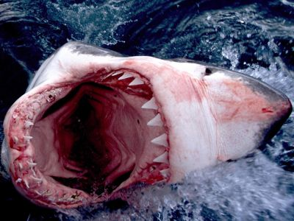
Not much time to do something!

